Slide 1
XR TECH
Presented by
Xuhan Liu
Gayeon Kim

Slide 2

About XR TECH
Allows user to browse electronic devices
Shows multiple photos, price and description
Simple design, easy to use

Slide 3
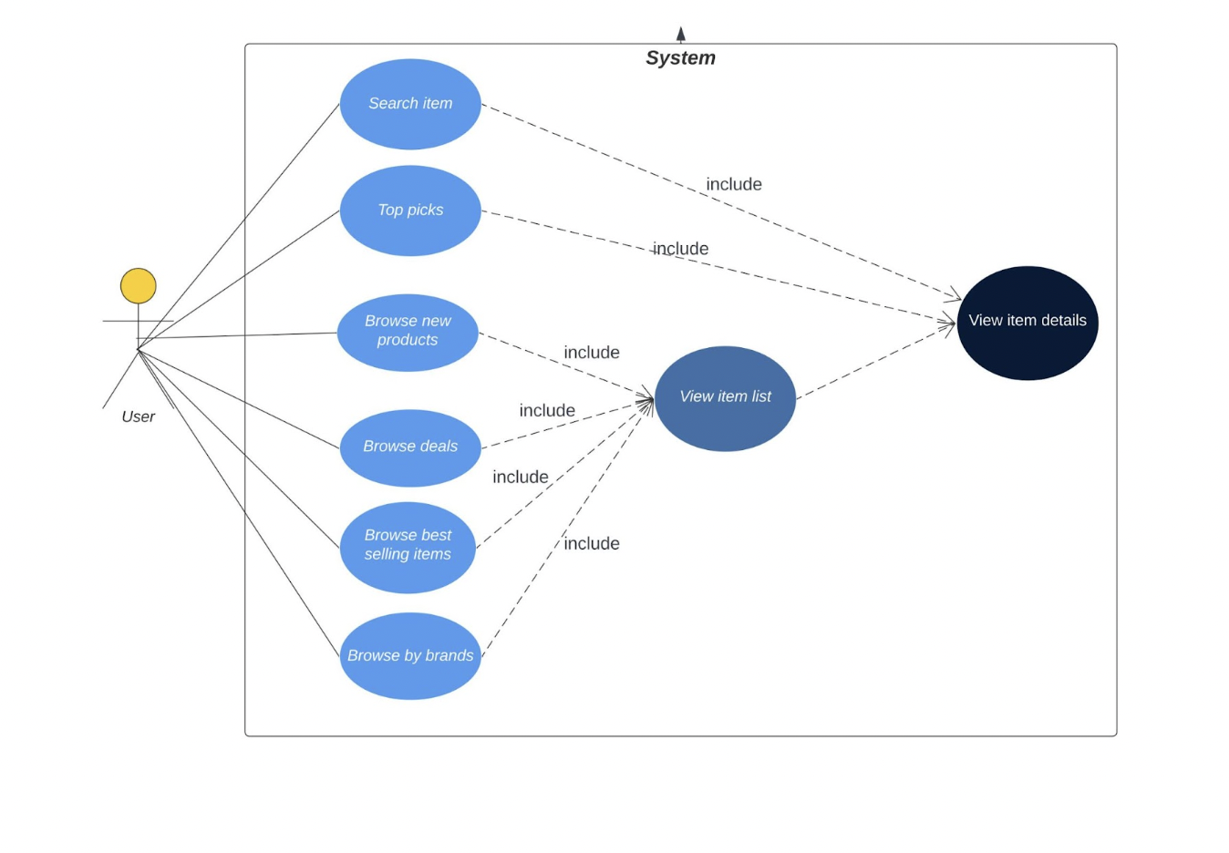
Use case diagram

Slide 4
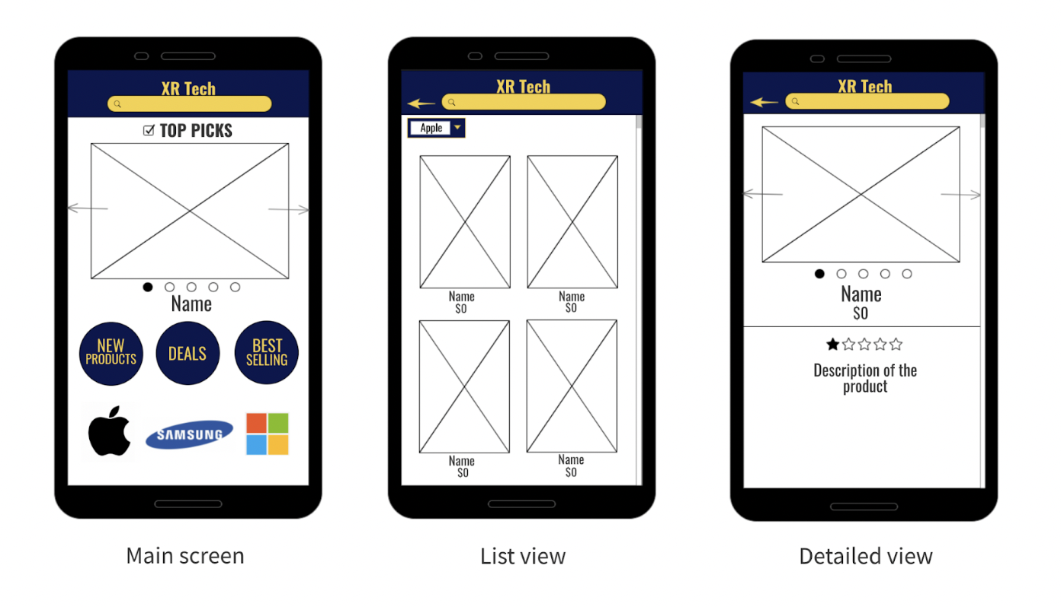
Design plan

Slide 5

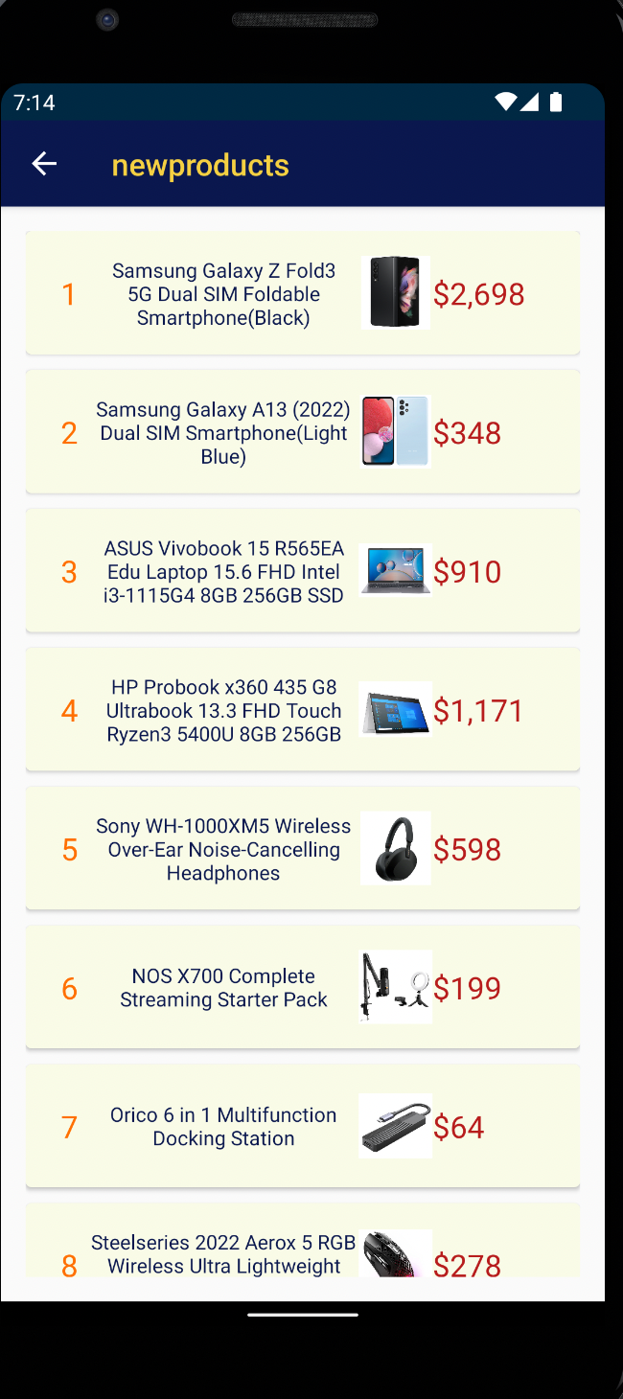
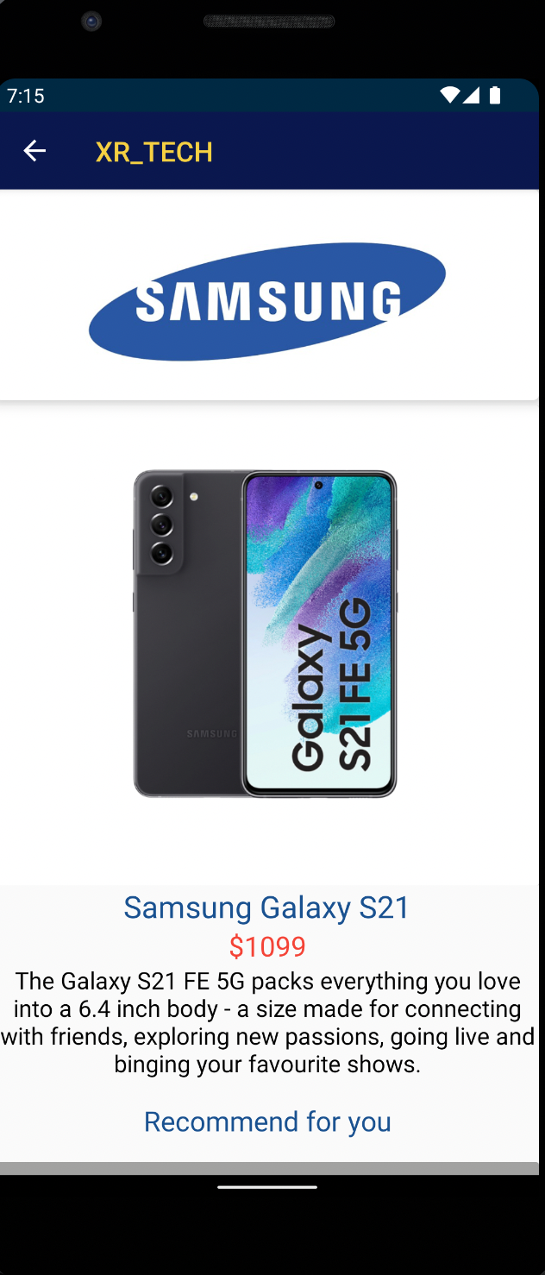
XR TECH Application
Main screen
List view
Detailed view

